Slide 1

REED Solomon Codes
Information theory
Final Project
Submitted by: Vladimir (Vova) Psevkin

Slide 2

Contents
Objective
Introduction
Error Detection Schemes
RS Encoding and Decoding
Reed Solomon Code

Slide 3
Objective
To Implement Reed Solomon error correcting codes by designing an efficient encoder and decoder for Reed Solomon Codes.
This can be done by programming using Python.

Slide 4
iNTRODUCTION
Transmitter
Communication Channel
Reciever
Data Source
Data Sink
Noisy Channel

Slide 5
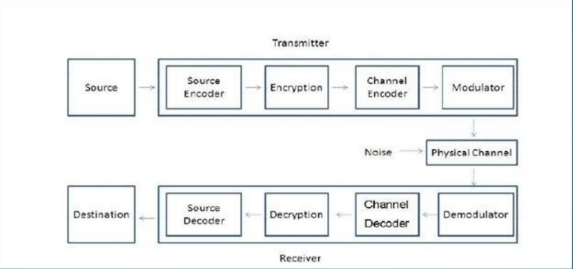
Complete Diagram of Communication System

Slide 6
Error Control Mechanism
Forward Error Control (FEC)
Automatic Repeat Request (ARQ)
FEC:
Data
Error Detection
Error Correction
Decoder
Message
…
Channel
Recovered

Slide 7
Types of FEC:
Block Codes
Convolutional Cods
ARQ:
Data
Data
Encoder
Error detection
Decoder

Slide 8


Linear Block Codes
The parity bits of linear block codes are linear combination of the message.
Linearity:
$if m_{1}⟶c_{1} and{ m}_{2}⟶c_{2}$
$then m_{1}⊕m_{2}{⟶c}_{1}⊕c_{2}$
where m is a k-bit information sequence c is an n-bit codeword. ⊕ is a bit-by-bit mod-2 addition without carry
Linear code: The sum of any two code words is a codeword.

Slide 9
Error Detection Schemes
Repetition scheme
Parity scheme
Checksum Scheme
Polarity scheme
Cyclic Redundancy Check scheme

Slide 10
Reed Solomon Codes
Reed Solomon code is a linear cyclic systematic non-binary block code.
RS codes operate on the information by dividing the
message stream into blocks of data, adding redundancy per block depending only on the current inputs.
It is capable to correct both burst errors and erasures.

Slide 11
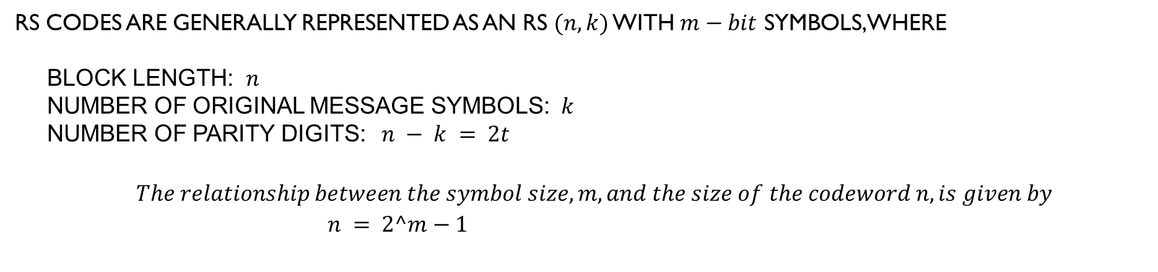
RS codes are generally represented as an RS $(n, k)$ with $m−bit$ symbols, where
Block Length: $n$
Number of Original Message symbols: $k$
Number of Parity Digits: $n − k = 2t$
$$The relationship between the symbol size, m, and the size of the codeword n, is given by \\ n = 2^m−1$$
k
2t
Data
Parity
n

Slide 12
Example
A popular Reed-Solomon code is RS(255,223) with 8-bit symbols.
Each codeword contains 255 code word bytes, of which 223 bytes are data and 32 bytes are parity.
For this code: n = 255, k = 223, s = 8
2t = 32, t = 16
The decoder can correct any 16 symbol errors in the code word: i.e. errors
in upto 16 bytes anywhere in the codeword can be automatically
corrected.

Slide 13
Reed Solomon Encoding
A generator polynomial is generated.
Message signal is multiplied with generator polynomial.

Slide 14
Reed Solomon Decoding
RS decoding is done in four levels.
The third is to calculate magnitude of error.
Forth one is the error evaluation which corrects the error.
Syndrome calculation -- It tells us whether an error has occurred during the transmission of data.
The second step includes error location which tells us where the error is present.

Slide 15
Advantage of Reed Solomon Code
The coding rate is very high for Reed Solomon code so it is suitable for many applications including storage and transmission. Coding Rate = $\frac{k}{n}$
The coding rate is very high for Reed Solomon code so it is suitable for many applications including storage and transmission. Coding Rate = 𝑘/𝑛
Coding gain is very high and less then LDPC and TURBO codes..
Reed-Solomon codes are most widely used to correcting burst errors.
RS decoding is done in four levels.
Coding gain is the measure in the difference between the signal-to-noise ratio (SNR) levels between the uncoded system and coded system needed to
achieve a given Bit Error Probability.

Slide 16
Application of Reed Solomon Code
Storage devices (including tape, Compact Disk, DVD etc)
Satellite communications
Digital television
Wireless or mobile communications ( cellular telephones, microwave links, etc)

Slide 17
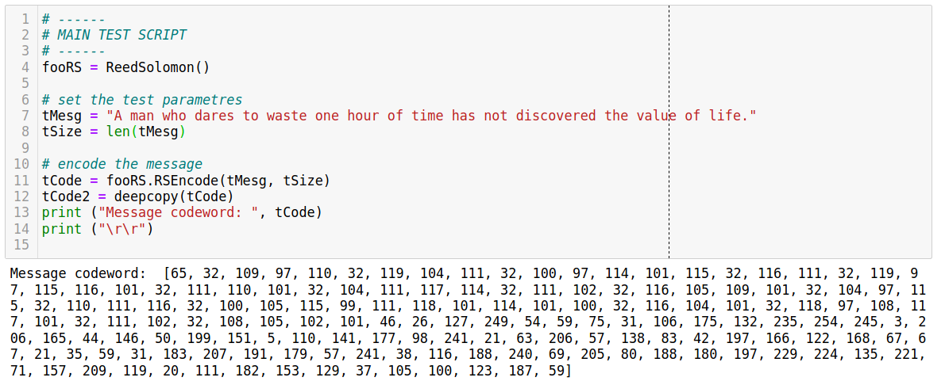
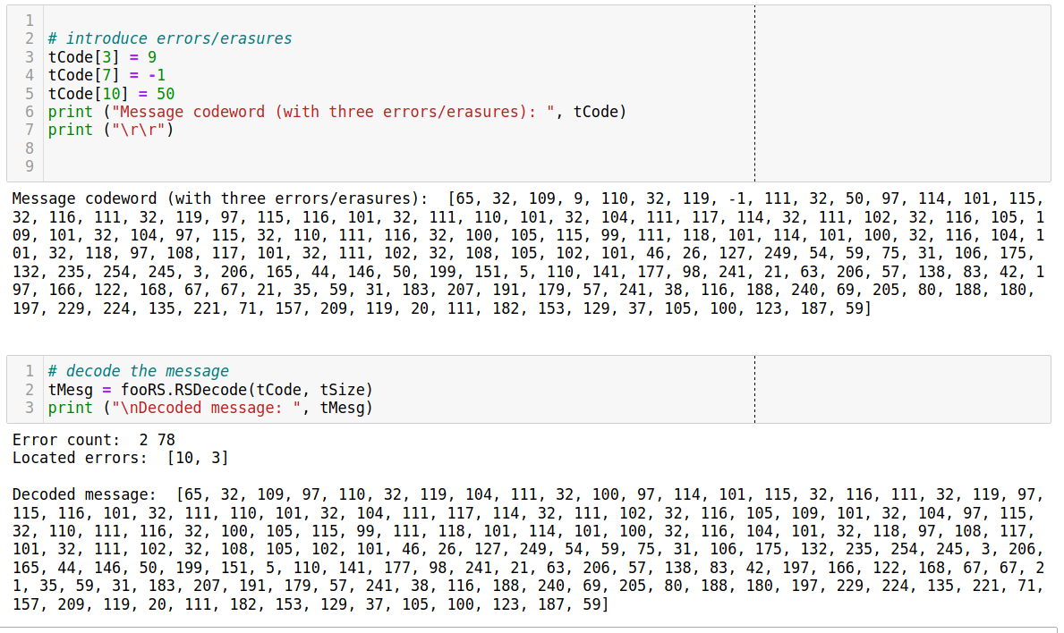
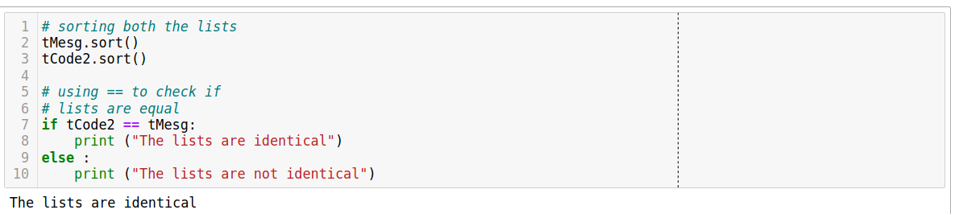
Code Python Example

Slide 18
Thank You
Psevkin@gmailcom

